Slide 1
Chapter 5: The Normal Distribution

Slide 2
Introduction
Empirical distributions.
Normal distribution.
Approximate theoretical values.
Basis for empirical distribution.
Notes:
Satisfies Learning Objective 5.1: Explain the importance and use of the normal distribution in statistics.
Empirical distributions: They are all based on real data. The distributions that we have described so far are all empirical distributions.
The normal distribution is a theoretical distribution, similar to an empirical distribution in that it can:
Be organized into frequency distributions.
Displayed using graphs.
Described by its central tendency and variation using measures such as the mean and the standard deviation.
Approximate theoretical values: Many empirical distributions seem to approximate the value of the theoretical normal distribution.
Basis for empirical distribution: To learn a lot about the characteristics of empirical distributions based on our knowledge of the theoretical normal distribution.

Slide 3
Properties of Normal Distribution (1 of 6)
A bell-shaped curve.
Perfect symmetry.
Point of maximum frequency.
Point where three measures coincide.
Notes:
Satisfies Learning Objective 5.2: Describe the properties of the normal distribution.
The normal curve is bell-shaped and shows perfect symmetry.
Perfect symmetry: This means that precisely half the observations fall on each side of the middle of the distribution.
Point of maximum frequency: The midpoint of the normal curve is the point having the maximum frequency.
This is also the point at which three measures coincide:
The mode (the point of the highest frequency).
The median (the point that divides the distribution into two equal halves).
The mean (the average of all the scores).

Slide 4
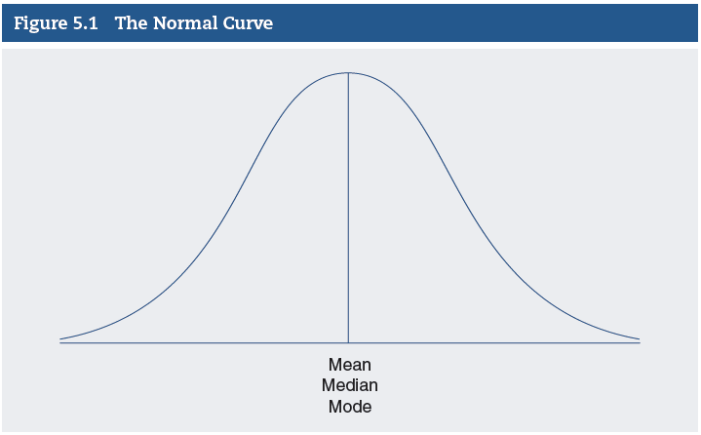
Properties of Normal Distribution (2 of 6)
Notes:
Satisfies Learning Objective 5.2: Describe the properties of the normal distribution.
Figure 5.1: A normal curve.
Figure 5.1 shows a normal curve.

Slide 5
Properties of Normal Distribution (3 of 6)
Empirical Distributions Approximating the Normal Distribution
Normal curve is theoretical.
Many variables resemble model.
Bell-shaped curve.
Describes empirical distributions.
Notes:
Satisfies Learning Objective 5.2: Describe the properties of the normal distribution.
Normal curve theoretical: The normal curve is a theoretical ideal, and real-life distributions never match this model perfectly.
Many variables resemble model: Researchers study many variables that closely resemble this theoretical model.
Bell-shaped curve: When a variable is “normally distributed,” the graphic display will reveal an approximately bell-shaped and symmetrical distribution closely resembling the idealized model.
Describes empirical distributions: This property makes it possible for us to describe many empirical distributions based on our knowledge of the normal curve.

Slide 6
Properties of Normal Distribution (4 of 6)
Areas under the Normal Curve
Measured in standard deviation units.
Conceptualized as percentage.
Curve symmetrical.
Signs show standard deviation.
Notes:
Satisfies Learning Objective 5.2: Describe the properties of the normal distribution.
Measured in standard deviation units: In all normal curves, a constant proportion of the area under the curve lying between the mean and any given distance from the mean when measured in standard deviation units.
Conceptualized as percentage: The area under the normal curve may be conceptualized as a proportion or percentage of the number of observations in the sample.
Curve symmetrical: Because the normal curve is perfectly symmetrical, exactly 0.50 or 50% of the observations lie above or to the right of the center, which is the mean of the distribution, and 50% lie below or to the left of the mean.
Signs show standard deviation: The plus signs indicate standard deviations above the mean; the minus signs denote standard deviations below the mean.

Slide 7
Properties of Normal Distribution (5 of 6)
Interpreting the Standard Deviation
Distance from mean and areas under curve.
Percentage between any score and mean.
Important interpretation for standard deviation.
Percentage of scores within any distance.
Notes:
Satisfies Learning Objective 5.2: Describe the properties of the normal distribution.
Distance from mean and areas under curve: The fixed relationship between the distance from the mean and the areas under the curve represents a property of the normal curve that has highly practical applications.
Percentage between any score and mean: As long as a distribution is normal and we know the mean and the standard deviation, we can determine the proportion or percentage of cases that fall between any score and the mean.
Important interpretation for standard deviation: This property provides an important interpretation for the standard deviation of empirical distributions that are approximately normal.
Percentage of scores within any distance: For such distributions, knowing the mean and the standard deviation, one can determine the percentage or proportion of scores that are within any distance, measured in standard deviation units, from that distribution’s mean.

Slide 8
Properties of Normal Distribution (6 of 6)
Table 5.1 2018 SAT Component Means and Standard Deviations for High
School Graduates Who Took the SAT During High School
Number of Total Test Takers | Evidence-Based Reading and Writing (ERW) |  | Mathematics
 | Mean | Standard Deviation | Mean | Standard Deviation
2,136,539 | 536 | 102 | 531 | 114
Source: SAT Suite of Assessments Annual Report: Total Group. Copyright  2018. The College Board. www.collegeboard.org
Notes:
Satisfies Learning Objective 5.2: Describe the properties of the normal distribution.
Table 5.1: 2018 SAT Component Means and Standard Deviations for High School Graduates Who Took the SAT During High School.
Table 5.1 shows 2018 SAT component means and standard deviations for high school graduates who took the SAT during high school.
An application of the normal curve:
For the rest of this chapter discussion, we rely on the results of the 2018 SAT examination.
The current SAT includes two components:
Evidence-based reading and writing (ERW).
Mathematics.
3. The perfect score for each component is 800, for a total possible of 1600.
4. The results of the SAT exam, combined or for each component, are assumed to be normally distributed.
5. Throughout this chapter, we will use the normal (theoretical) curve to describe and better understand the characteristics of the SAT ERW empirical (real data) distribution.

Slide 9
An Application of the Normal Curve (1 of 3)
SAT includes two components.
Results of SAT exam.
SAT ERW empirical distribution.
Notes:
Satisfies Learning Objective 5.3: Transform a raw score into standard (Z) score and vice versa.
SAT includes two components:
Evidence-based reading and writing (ERW).
Mathematics.
Results of SAT exam: The results of the SAT exam, combined or for each component, are assumed to be normally distributed.
SAT ERW empirical distribution: One will use the normal (theoretical) curve to describe and better understand the characteristics of the SAT ERW empirical (real data) distribution.

Slide 10
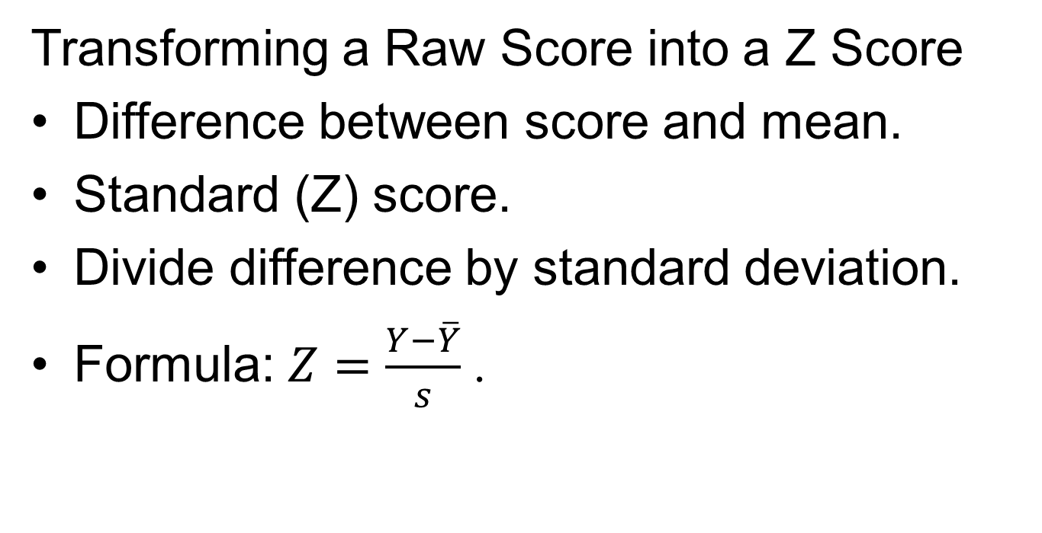
An Application of the Normal Curve (2 of 3)
Transforming a Raw Score into a Z Score
Difference between score and mean.
Standard (Z) score.
Divide difference by standard deviation.
Formula: $Z=\frac{Y−\overline{Y}}{s}$.
Notes:
Satisfies Learning Objective 5.3: Transform a raw score into standard (Z) score and vice versa.
Difference between score and mean: We can express the difference between any score in a distribution and the mean in terms of standard scores, also known as Z scores.
A standard (Z) score is the number of standard deviations that a given raw score (or the observed score) is above or below the mean.
Divide difference by standard deviation: To transform a raw score into a Z score, we divide the difference between the score and the mean by the standard deviation.
This calculation gives us a method of standardization known as transforming a raw score into a Z score (also known as a standard score).
Formula: $Z=\frac{Y−\overline{Y}}{s}$.

Slide 11
An Application of the Normal Curve (3 of 3)
Transforming a Raw Score into a Z Score
Raw score in terms of relationships.
Distance of raw score from mean.
Positive Z and negative Z.
Larger Z score.
Notes:
Satisfies Learning Objective 5.3: Transform a raw score into standard (Z) score and vice versa.
Raw score in terms of relationships: A Z score allows us to represent a raw score in terms of its relationship to the mean and to the standard deviation of the distribution.
Distance of raw score from mean: It represents how far a given raw score is from the mean in standard deviation units.
Positive Z and negative Z: A positive Z indicates that a score is larger than the mean, and a negative Z indicates that it is smaller than the mean.
The larger the Z score, the larger the difference between the score and the mean.

Slide 12
The Standard Normal Distribution (1 of 2)
Distance between actual score and mean.
Values of mean and standard deviation.
Relationship between raw scores and Z scores.
Notes:
Satisfies Learning Objective 5.4: Transform a Z score into proportion (or percentage) and vice versa.
When a normal distribution is represented in standard scores (Z scores), we call it the standard normal distribution.
Distance between actual score and mean: Standard scores, or Z scores, are the numbers that tell us the distance between an actual score and the mean in terms of standard deviation units.
Values of mean and standard deviation: The standard normal distribution has a mean of 0.0 and a standard deviation of 1.0.
Relationship between raw scores and Z scores: To understand the relationship between raw scores of a distribution and their respective standard Z scores, the SAT ERW scores that correspond to these standard scores are shown:
For example, the mean for the SAT ERW distribution is 536 and the corresponding Z score, the mean of the standard normal distribution is 0.
As calculated, the score of 638 is 1 standard deviation above the mean (536 + 102 = 638); therefore, its corresponding Z score is +1.
The score of 434 is 1 standard deviation below the mean (536 − 102 = 434), and its Z-score equivalent is −1.

Slide 13
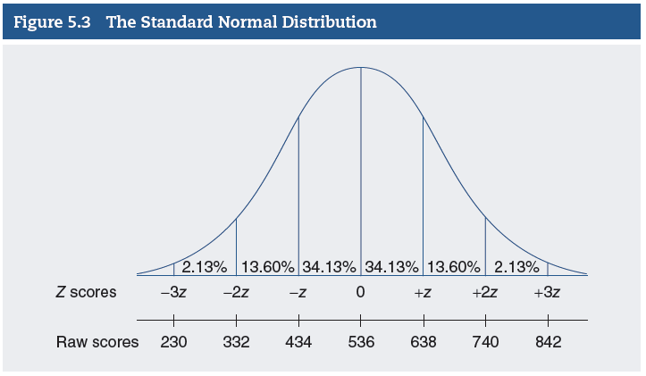
The Standard Normal Distribution (2 of 2)
Notes:
Satisfies Learning Objective 5.4: Transform a Z score into proportion (or percentage) and vice versa.
Figure 5.3: A standard normal distribution with areas under the curve associated with 1, 2, and 3 standard scores above and below the mean.

Slide 14
The Standard Normal Table (1 of 17)
Areas under Z score organized in a table.
Consists of three columns.
Examples on how to transform Z scores into percentages.
Notes:
Satisfies Learning Objective 5.4: Transform a Z score into proportion (or percentage) and vice versa.
Standard normal table: The areas or proportions under the standard normal curve, corresponding to any Z score or its fraction, are organized into a special table called the standard normal table.
The table consists of three columns:
Column A lists positive Z scores:
Because the normal curve is symmetrical, the proportions that correspond to positive Z scores are identical to the proportions corresponding to negative Z scores.
Column B shows the area included between the mean and the Z score listed in Column A:
When Z is positive, the area is located on the right side of the mean.
For a negative Z score, the same area is located left of the mean.
Column C shows the proportion of the area that is beyond the Z score listed in Column A:
Areas corresponding to positive Z scores are on the right side of the curve.
Areas corresponding to negative Z scores are identical except that they are on the left side of the curve.
Examples on how to transform Z scores into percentages: Four sections form examples of how to transform Z scores into proportions or percentages to describe different areas of the empirical distribution of SAT ERW scores.

Slide 15
The Standard Normal Table (2 of 17)
Table 5.2 The Standard Normal Table
(A) | (B) | (C) | (A) | (B) | (C)
Z | Area Between Mean and Z | Area Beyond Z | Z | Area Between Mean and Z | Area Beyond Z
0.00 | 0.0000 | 0.5000 | 0.21 | 0.0832 | 0.4168
0.01 | 0.0040 | 0.4960 | 0.22 | 0.0871 | 0.4129
0.02 | 0.0080 | 0.4920 | 0.23 | 0.0910 | 0.4090
0.03 | 0.0120 | 0.4880 | 0.24 | 0.0948 | 0.4052
0.04 | 0.0160 | 0.4840 | 0.25 | 0.0987 | 0.4013
0.05 | 0.0199 | 0.4801 | 0.26 | 0.1026 | 0.3974
0.06 | 0.0239 | 0.4761 | 0.27 | 0.1064 | 0.3936
0.07 | 0.0279 | 0.4721 | 0.28 | 0.1103 | 0.3897
0.08 | 0.0319 | 0.4681 | 0.29 | 0.1141 | 0.3859
0.09 | 0.0359 | 0.4641 | 0.30 | 0.1179 | 0.3821
0.10 | 0.0398 | 0.4602 | 0.31 | 0.1217 | 0.3783
Notes:
Satisfies Learning Objective 5.4: Transform a Z score into proportion (or percentage) and vice versa.
Table 5.2 reproduces a small part of the standard normal table.

Slide 16
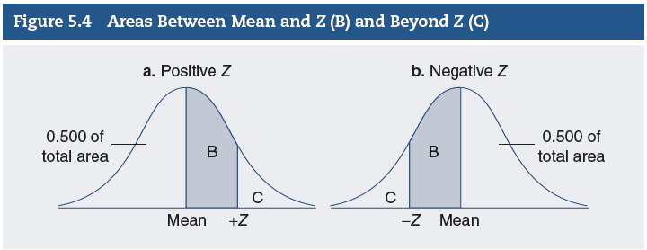
The Standard Normal Table (3 of 17)
Notes:
Satisfies Learning Objective 5.4: Transform a Z score into proportion (or percentage) and vice versa.
Figure 5.4a: Area for positive Z score.
Figure 5.4a shows the area for positive Z score.
Figure 5.4b: Area for negative Z score.
Figure 5.4b shows the area for negative Z score.

Slide 17
The Standard Normal Table (4 of 17)
Finding the Area between the Mean and a Positive or Negative Z Score
Standard normal table to find area.
Multiply proportion by number of students.
Steps for scores lower than mean.
Notes:
Satisfies Learning Objective 5.4: Transform a Z score into proportion (or percentage) and vice versa.
Standard normal table to find area: We can use the standard normal table to find the area between the mean and specific Z scores.
Multiply proportion by number of students: To find the actual number of students who scored between two scores, multiply the proportion by the total number of students.
Steps for scores lower than mean: For a score lower than the mean, we can use the standard normal table and the following steps:
Convert the score to a Z score.
Because the proportions that correspond to positive Z scores are identical to the proportions corresponding to negative Z scores, ignore the negative sign of Z and look up in Column A.
The area corresponding to a Z score indicates the area under the curve is included between the mean and a Z value.
We convert this proportion to a percentage.
Thus, percentage of the distribution lies between the scores.

Slide 18
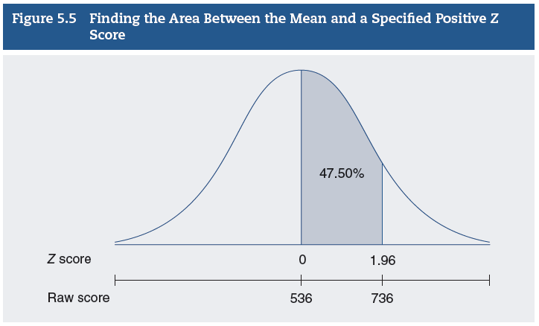
The Standard Normal Table (5 of 17)
Finding the Area between the Mean and a Positive or Negative Z Score
Notes:
Satisfies Learning Objective 5.4: Transform a Z score into proportion (or percentage) and vice versa.
We can use the standard normal table to find the area between the mean and specific Z scores. To find the area between 536 and 736, follow these steps:
Convert 675 to a Z score: (736 – 536)/102 = 200/102 = 1.96.
Look up 1.96 in Column A (in Appendix B) and find the corresponding area in Column B, 0.4750. We can translate this proportion into a percentage (0.4750 × 100 = 47.50%) of the area under the curve included between the mean and a Z score of 1.96.
Thus, 47.50% of the total area lies between 536 and 736.
To find the actual number of students who scored between 536 and 736, multiply the proportion 0.4750 by the total number of students.
Thus, 1014,856 students (0.4750 × 2136,539 = 1014,856) obtained a score between 536 and 736.

Slide 19
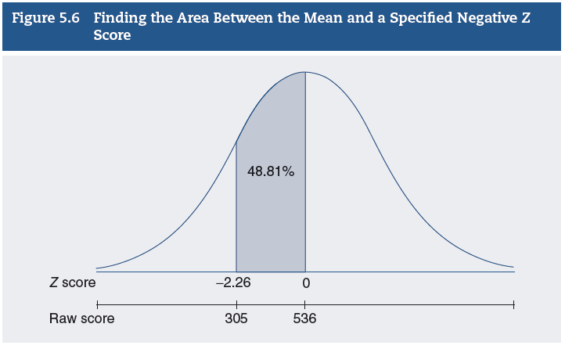
The Standard Normal Table (6 of 17)
Finding the Area between the Mean and a Positive or Negative Z Score
Notes:
Satisfies Learning Objective 5.4: Transform a Z score into proportion (or percentage) and vice versa.
For a score lower than the mean, such as 305, we can use the standard normal table and the following steps:
Convert 305 to a Z score: (305 − 536)/102 = (−231)/102 = −2.26.
Because the proportions that correspond to positive Z scores are identical to the proportions corresponding to negative Z scores, we ignore the negative sign of Z and look up 2.26 in Column A.
The area corresponding to a Z score of 1.56 is 0.4881. This indicates that 0.4881 of the area under the curve is included between the mean and a Z of −2.26.
We convert this proportion to a percentage, 48.81%.
Thus, 48.81% of the distribution lies between the scores 305 and 536.

Slide 20
The Standard Normal Table (7 of 17)
Finding the Area above a Positive Z Score or below a Negative Z Score
Used to find area beyond Z score.
Identifying on opposite end of distribution.
Notes:
Satisfies Learning Objective 5.4: Transform a Z score into proportion (or percentage) and vice versa.
Used to find area beyond Z score: The normal distribution table can also be used to find the area beyond a Z score, SAT scores that lie at the tip of the positive or negative sides of the distribution.
Identifying on opposite end of distribution: A similar procedure can be applied to identify the number of students on the opposite end of the distribution.
Let’s first convert a score to a Z score.
The area beyond a Z includes all students who scored below target score.
Locate the proportion of students in this area in Column C in the entry corresponding to a Z.
Remember that the proportions corresponding to positive or negative Z scores are identical.

Slide 21
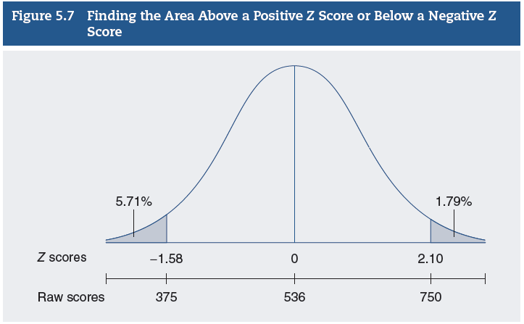
The Standard Normal Table (8 of 17)
Finding the Area above a Positive Z Score or below a Negative Z Score
Notes:
Satisfies Learning Objective 5.4: Transform a Z score into proportion (or percentage) and vice versa.
Finding the area above a positive Z score or below a negative Z score:
The normal distribution table can also be used to find the area beyond a Z score, SAT scores that lie at the tip of the positive or negative sides of the distribution (Figure 5.7).
For example, what is the area below a score of 750? The Z score corresponding to a final SAT ERW score of 750 is equal to 2.10 (750 – 536)/102 = 214/102 = 2.10.
The area beyond a Z of 2.10 includes all students who scored above 750.
This area is shown in Figure 5.7.
To find the proportion of students whose scores fall in this area, refer to the entry in Column C that corresponds to a Z of 2.10, 0.0179.
This means that 1.79% (0.0179 × 100 = 1.79%) of the students scored above 750, a very small percentage.
To find the actual number of students in this group, multiply the proportion 0.0179 by the total number of students.
Thus, there were 2136,539 × 0.0179, or about 38,244 students, who scored above 750.
A similar procedure can be applied to identify the number of students on the opposite end of the distribution.
Let’s first convert a score of 375 to a Z score: (375 – 536)/102 = (–161)/102 = –1.58.
The Z score corresponding to a final score of 375 is equal to −1.58.
The area beyond a Z of –1.58 includes all students who scored below 375. This area is also shown in Figure 5.7.
Locate the proportion of students in this area in Column C in the entry corresponding to a Z of –1.58.
Remember that the proportions corresponding to positive or negative Z scores are identical.
This proportion is equal to 0.0571.
Thus, 5.71% (0.0571 x 100) of the group, or about 121,996 (0.0571 x 2136,539) students, performed poorly on the ERW portion of the SAT exam.

Slide 22
The Standard Normal Table (9 of 17)
Transforming Proportions and Percentages into Z Scores
Finding a Z score which bounds an area above It.
Finding a Z score which bounds an area below it.
Notes:
Satisfies Learning Objective 5.4: Transform a Z score into proportion (or percentage) and vice versa.
Finding a Z score which bounds an area above it:
To identify the score that corresponds to the top 10% of SAT test takers, we will need to identify the cutoff point for the top 10% of the class. This problem involves two steps:
Find the Z score that bounds the top 10% or 0.1000 (0.1000 × 100 = 10%) of all the students who took the ERW SAT (Figure 5.8).
Refer to the areas under the normal curve shown in Appendix B.
Find the score associated with a Z of 1.28.
To transform a Z score into a raw score, we multiply the score by the standard deviation and add that product to the mean: $Y= \overline{Y}+Z\left(s\right).$
Finding a Z score which binds an area below it:
To identify the score which corresponds to the bottom 5% of test takers, the problem involves two steps:
Find the Z score that bounds the lowest 5% or 0.0500 of all the students who took the class.
Refer to the areas under the normal curve and look for an entry of 0.0500 (or the value closest to it) in Column C.
To find the final ERW score associated with a Z of −1.65.
Convert the Z score to a raw score.

Slide 23
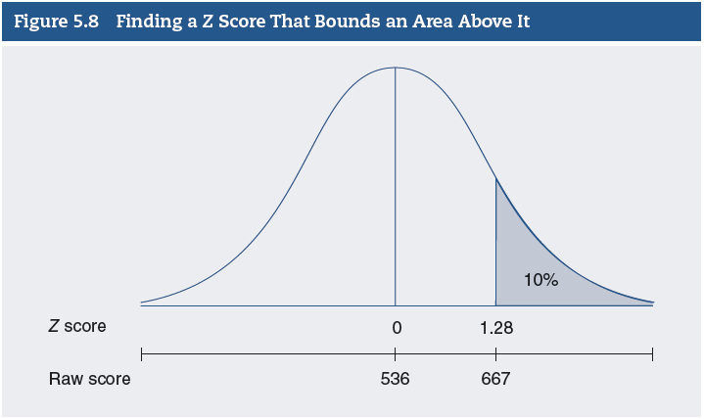
The Standard Normal Table (10 of 17)
Transforming Proportions and Percentages into Z Scores
Notes:
Satisfies Learning Objective 5.4: Transform a Z score into proportion (or percentage) and vice versa.
Figure 5.8: The Z score that bounds the top 10% or 0.1000 (0.1000 × 100 = 10%) of all the students who took the ERW SAT.

Slide 24
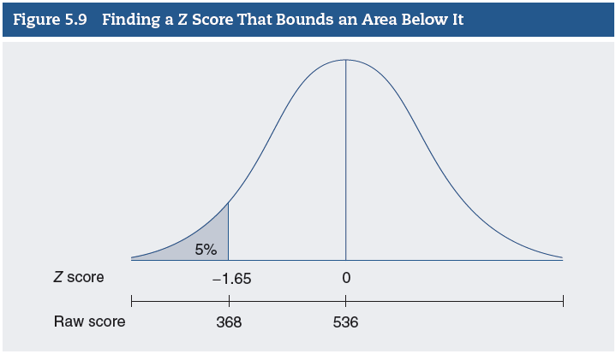
The Standard Normal Table (11 of 17)
Transforming Proportions and Percentages into Z Scores
Notes:
Satisfies Learning Objective 5.4: Transform a Z score into proportion (or percentage) and vice versa.
Figure 5.9: Z score that bounds the lowest 5% or 0.0500 of all the students who took the class.

Slide 25
The Standard Normal Table (12 of 17)
Working with Percentiles in a Normal Distribution
Determine percentile rank of raw score.
Finding the percentile rank of a score higher than the mean.
Finding the percentile rank of a score lower than the mean.
Notes:
Satisfies Learning Objective 5.5: Calculate and interpret the percentile rank of a score.
To determine the percentile rank of a raw score requires transforming Z scores into proportions or percentages.
Finding the percentile rank of a score higher than the mean:
To find the percentile rank of a score higher than the mean, follow these steps:
Convert the raw score to a Z score.
Find the area beyond Z in Appendix B, Column C.
Subtract the area from 1.00 and multiply by 100 to obtain the percentile rank.
Being in the 92nd percentile means that 92% of all test takers scored lower than raw score and 8% scored higher than raw score.
Finding the percentile rank of a score lower than the mean:
To find the percentile rank of a score lower than the mean, follow these steps:
Convert the raw score to a Z score.
Find the area beyond Z in Appendix B, Column C.
Multiply the area by 100 to obtain the percentile rank.
The 20th percentile rank means that 20% of all test takers scored lower than you.

Slide 26
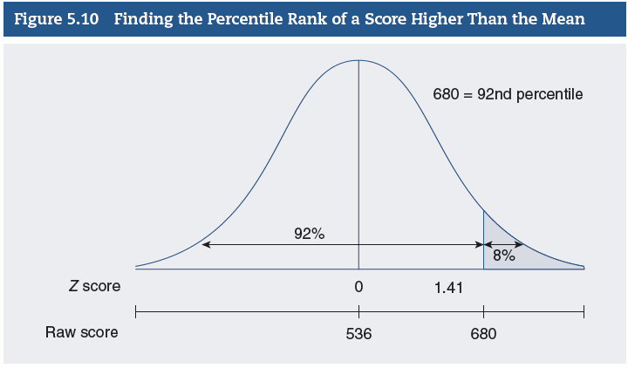
The Standard Normal Table (13 of 17)
Working with Percentiles in a Normal Distribution
Notes:
Satisfies Learning Objective 5.5: Calculate and interpret the percentile rank of a score.
Figure 5.10 illustrates this problem: Suppose you took the SAT writing exam during the same year. You recall that your final score was 680, but how well did you do relative to the other students who took the exam? To evaluate your performance, you need to translate your raw score into a percentile rank.

Slide 27
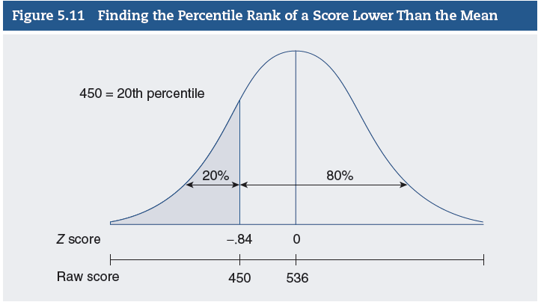
The Standard Normal Table (14 of 17)
Working with Percentiles in a Normal Distribution
Notes:
Satisfies Learning Objective 5.5: Calculate and interpret the percentile rank of a score.
Figure 5.11 illustrates this problem: If your SAT score is 450, what is your percentile rank?

Slide 28
The Standard Normal Table (15 of 17)
Working with Percentiles in a Normal Distribution
Finding a raw score associated with a percentile higher than 50.
Finding the raw score associated with a percentile lower than 50.
Notes:
Satisfies Learning Objective 5.5: Calculate and interpret the percentile rank of a score.
Finding a raw score associated with a percentile higher than 50:
To find the score associated with a percentile higher than 50, follow these steps:
Divide the percentile by 100 to find the area below the percentile rank.
Subtract the area below the percentile rank from 1.00 to find the area above the percentile rank.
Find the Z score associated with the area above the percentile rank.
Refer to the area under the normal curve shown in Appendix B.
Convert the Z score to a raw score.
Finding the raw score associated with a percentile lower than 50:
To find the percentile rank of a score lower than 50 follow these steps:
Divide the percentile by 100 to find the area below the percentile rank.
Find the Z score associated with this area.
Refer to the area under the normal curve shown in Appendix B.
Convert the Z score to a raw score.

Slide 29
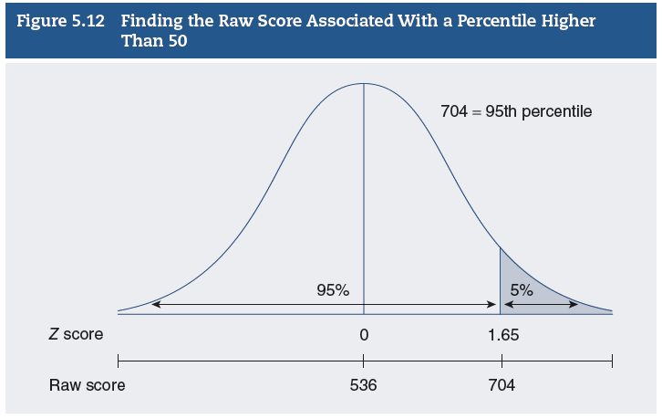
The Standard Normal Table (16 of 17)
Working with Percentiles in a Normal Distribution
Notes:
Satisfies Learning Objective 5.5: Calculate and interpret the percentile rank of a score.
Figure 5.12 illustrates this problem: Let’s assume that for an honors English program, your university will only admit students who scored at or above the 95th percentile in the SAT ERW exam. What is the cutoff point required for acceptance?

Slide 30
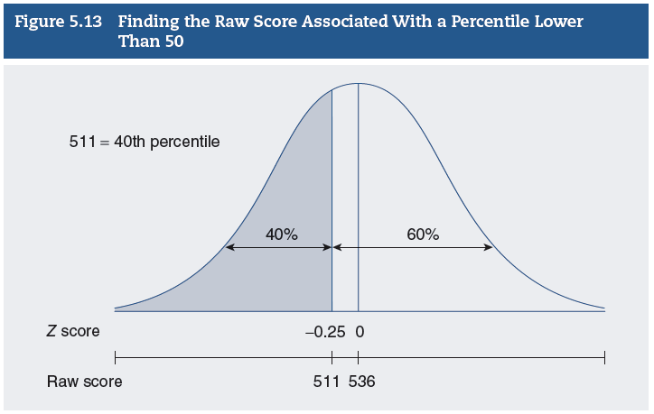
The Standard Normal Table (17 of 17)
Working with Percentiles in a Normal Distribution
Notes:
Satisfies Learning Objective 5.5: Calculate and interpret the percentile rank of a score.
Figure 5.13 illustrates this problem: What is the score associated with the 40th percentile?

Slide 31
Reading the Research Literature: Child Health and Academic Achievement
Margot Jackson’s study.
Relation of academic inequality to poor health.
Notes:
A study by Margot Jackson found that the role of health in producing academic inequality depends on when, and for how long, children are in poor health.

